Slide 1
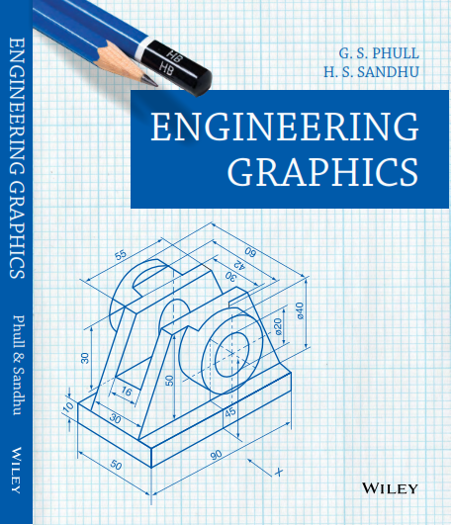

Slide 2
LETTERING
INSCRIPTIONS ACCOMPANYING THE DRAWING SHOULD BE MADE IN CLEAR AND PLEASING LETTERS AND FIGURES. SINCE ALL MECHANICAL PARTS ARE MADE TO DRAWINGS, CARELESS LETTERING MAY RESULT IN REJECTIONS.
LETTERS CAN BE DIVIDED BROADLY IN TWO TYPES:
1. UPPER CASE LETTERS
2. LOWER CASE LETTERS
THESE ARE FURTHER DIVIDED INTO TWO TYPES:
1. VERTICAL
2. ITALIC

Slide 3
LETTERING
THE FIRST REQUIREMENT IN LETTERING IS TO HOLD THE PENCIL CORRECTLY.
THE PENCIL SHOULD BE HELD COMFORTABLY WITH THE THUMB, FOREFINGER AND SECOND FINGER ON ALTERNATE FLAT SIDES AND THIRD AND FOURTH FINGERS ON THE PAPER.
VERTICAL SLANTING AND CURVED STROKES ARE DRAWN WITH A STEADY, EVEN, FINGER MOVEMENT.
HORIZONTAL STROKES ARE MADE SIMILARLY BUT WITH SOME PIVOTING OF THE HAND
AT THE WRIST.
THAT THE FIRST REQUIREMENT IN LETTERING IS TO HOLD THE PENCIL CORRECTLY.
EXERT PRESSURE, WHICH IS FIRM AND UNIFORM BUT NOT SO HEAVY AS TO CUT GROOVES IN THE PAPER.
TO KEEP THE POINT SYMMETRICAL, FORM THE HABIT OF ROTATING THE PENCIL AFTER EVERY FEW STROKES.

Slide 4
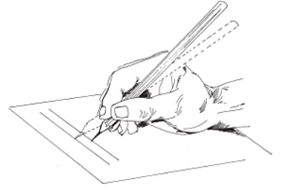
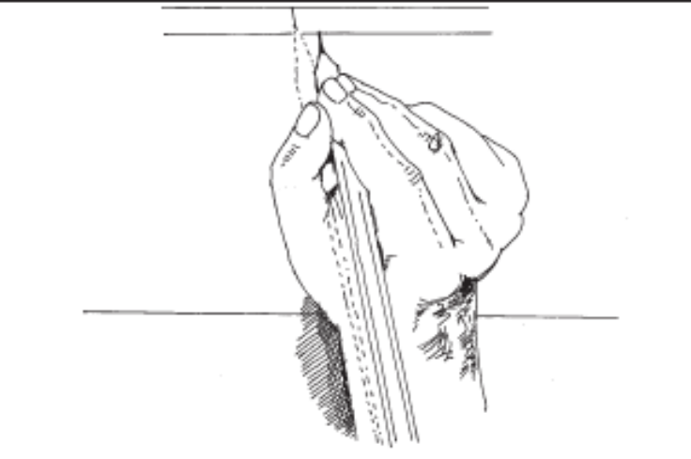
LETTERING
Vertical Stroke made by finger moment only
Horizontal stroke are made by pivoting the
the whole hand at the wrist

Slide 5
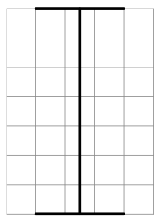
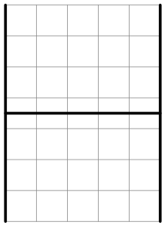
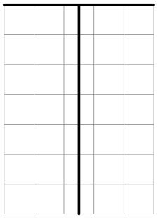
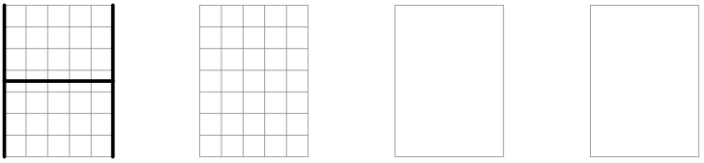
THE UPPERCASE(CAPITAL) GOTHIC LETTERS ARE ARRANGED INTO
GROUPS BASED ON ITS FORMATION
First group cointain: ‘I’, ‘H’, and ‘T’
The letter ‘I’ is the foundation stroke
The ‘H’ is nearly rectangular and the cross bar is just in centre
The top of ‘T’ is drawn first to the full width and the stem is drawn in the middle vertically
WRITE THE LETTERS BY MAKING GRID AND GUIDE LINES AS SHOWN

Slide 6
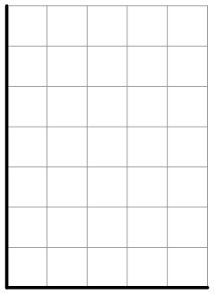
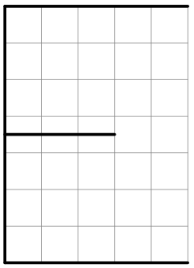
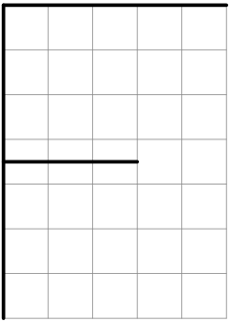
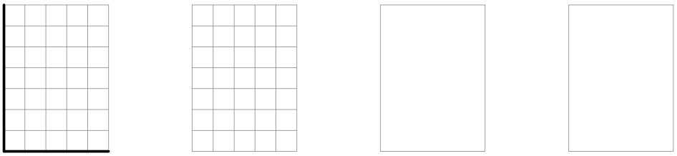
Second group cointain: ‘L’, ‘E’, and ‘F’
The letter ‘L’ is made in two strokes
The first two strokes of ‘E’ are the same as for the letter ‘L’ and the third upper stroke is equal. The fourth stroke will be drawn in the middle of the letter
The letter ‘F’ has the same proportions as for the letter ‘E’ except the lowest line
WRITE THE LETTERS BY MAKING GRID AND GUIDE LINES AS SHOWN

Slide 7
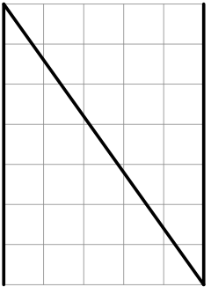
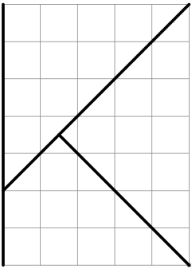
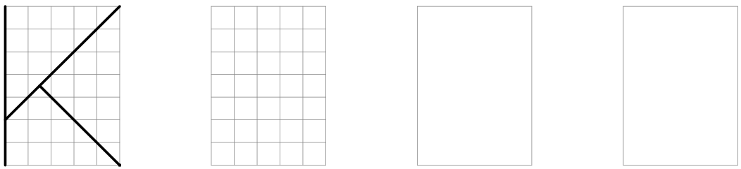
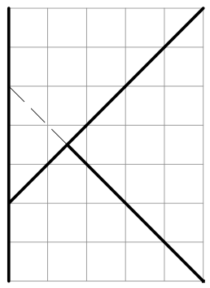
Third group cointain: ‘N’ and ‘K’
For letter ‘N’
the parallel sides are drawn first and then the slanting line is drawn
The second stroke of ‘K’ strikes the stem at two blocks above from the bottom, the third stroke branches from it in a direction starting from top of the stem
WRITE THE LETTERS BY MAKING GRID AND GUIDE LINES AS SHOWN

Slide 8
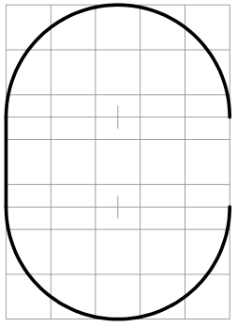
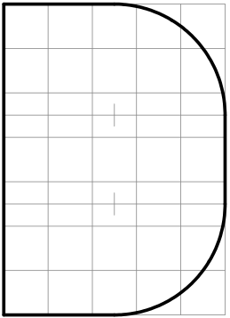
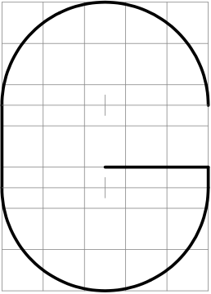
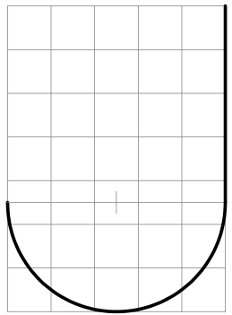
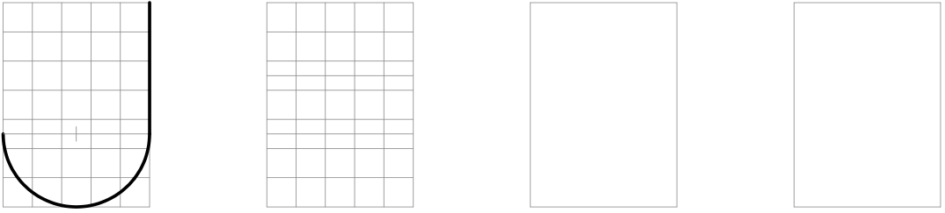
Now we club the letters based on there formation
WRITE THE LETTERS BY MAKING GRID AND GUIDE LINES AS SHOWN

Slide 9
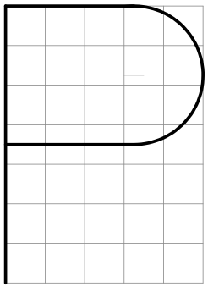
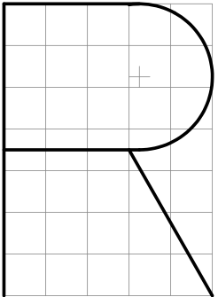
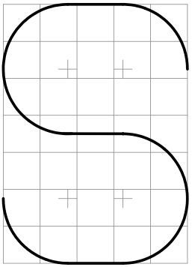
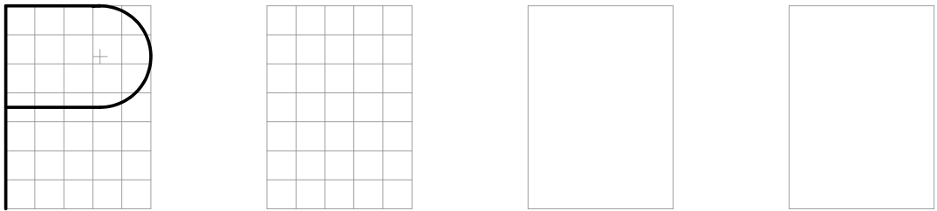
Letters based on there formation
WRITE THE LETTERS BY MAKING GRID AND GUIDE LINES AS SHOWN

Slide 10
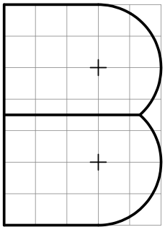
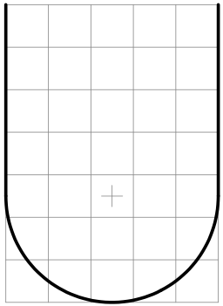
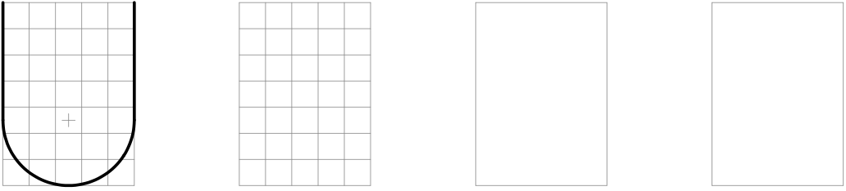
Letters based on there formation
WRITE THE LETTERS BY MAKING GRID AND GUIDE LINES AS SHOWN

Slide 11
Letters based there formation
WRITE THE LETTERS BY MAKING GRID AND GUIDE LINES AS SHOWN

Slide 12
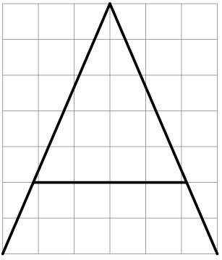
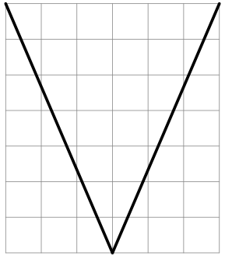
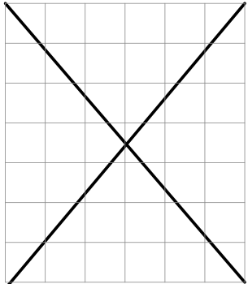
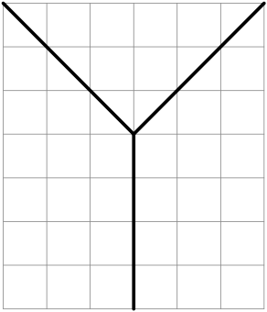
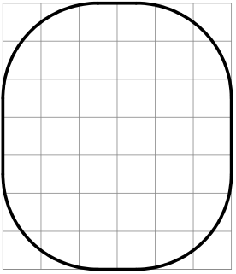
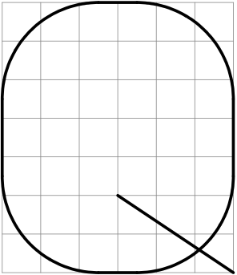
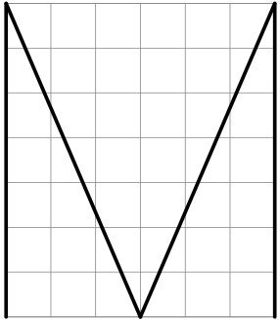
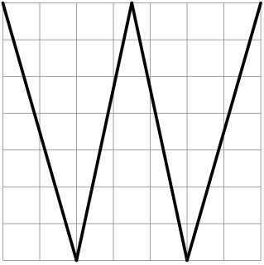
Letters based on there formation

Slide 13
SOME IMPORTANT POINTS
LETTERS SHOULD BE WRITTEN BY A SINGLE STROKE OF PENCIL AND NO SKETCHING IS DONE.
ALL LETTERS SHOULD BE UNIFORM IN SHAPE, SIZE, STROKE, SHADE AND SPACING.
THE SHINE AND BOLDNESS OF THE LETTERS AND NUMERALS SHOULD BE THE SAME.
THE LETTERS CAN BE WRITTEN IN THE EXPANDED OR COMPRESSED FORM ACCORDING
TO THE SPACE AVAILABLE FOR WRITING.
THE SPACE BETWEEN TWO LETTERS MUST BE KEPT UNIFORM AND A GAP EQUAL TO TWICE THE THICKNESS OF THE LETTER MAY BE KEPT BETWEEN TWO IN CERTAIN COMBINATIONS OF LETTERS (SUCH AS V AND A, L AND T, etc) THE SPACE BETWEEN THEM IS REDUCED SO AS TO MAKE IT SEEM EQUAL TO THAT BETWEEN OTHER LETTERS.
THE GUIDE LINES SHOULD BE DRAWN WITH ‘4H’ (THIN LINES) AND UNNECESSARY LINES MAY BE RUBBED OFF.

